Slide 1
Computer Organization
Micro Architecture Level
The Processor: Datapath and Control

Slide 2
Six Level Computer
LEVEL 5
Problem Oriented Language Level
(High Language Level)
Translation(Compiler)
LEVEL 4
Assembly Language Level
Translation(Assembler)
LEVEL 3
Operating System Machine Level
Partial Interpretation
(Operating System)
LEVEL 2
Instruction Set Architecture Level
Interpretation (Microprogram) /
Direct Execution (Hardwired)
LEVEL 1
Micro Architecture Level
Hardware
LEVEL 0
Digital Logic Level

Slide 3
GOAL: Datapath and control unit
Design a computer architecture
To support the defined ISA
To fetch and execute each instruction
Study of
Processor designs
• Single cycle
• Multiple cycle
• Pipelined

Slide 4
GOAL: Datapath and control unit
Study of
Datapath
• Basic components
• How a datapath is constructed?
• How the speed of the CPU is determined?
Control unit
• Why do we need control unit?
• How control unit relates instructions and datapath?
• Control unit design

Slide 5
Instruction Set Architecture (ISA)
A programmable system uses
A sequence of instructions to control its operation
A typical instruction specifies:
Operation to be performed
Operands to use
Where to place the result
Which instruction to execute next

Slide 6
Instruction Set Architecture (ISA) (cont.)
Instructions are stored in
RAM or ROM as a program
The addresses for instructions in a computer are provided by
A program counter (PC) that can
Count up
Load a new address based on an instruction and, optionally, status information

Slide 7
Instruction Set Architecture (ISA) (cont.)
Part of the Control Unit to execute an instruction
The PC and associated control logic
Executing an instruction –
Activating the necessary sequence of operations specified by the instruction
Controlled by the control unit and performed,
In the datapath
In the control unit
In external hardware such as memory or input/output

Slide 8
ISA: Instruction Format
A instruction consists of a bit vector
The fields of an instruction are subvectors representing specific functions and having specific binary codes defined
The format of an instruction defines the subvectors and their function
An ISA usually contains multiple formats

Slide 9
MIPS Instruction & instuction Formats
Simplified only for
Arithmetic-logic instructions : add, sub, and, or, slt
Memory-reference instructions : lw, sw
Control-flow instructions : beq, j
6 bits
5 bits
5 bits
5 bits
5 bits
6 bits
op
rs
rt
rd
shamt
funct
R-Format
6 bits
5 bits
5 bits
16 bits
op
rs
rt
offset
I-Format
6 bits
26 bits
J-Format
op
address

Slide 10
Implementing MIPS: the Fetch/Execute Cycle
High-level abstract view of fetch/execute implementation
use the program counter (PC) to read instruction address
fetch the instruction from memory and increment PC
use fields of the instruction to select registers to read
execute depending on the instruction
repeat…

Slide 11
Processor Implementation Styles
Single Cycle
Perform each instruction in 1 clock cycle
Clock cycle must be long enough for slowest instruction
Multi-Cycle
Break fetch/execute cycle into multiple steps
Perform 1 step in each clock cycle
Pipelined

Slide 12
Single Vs. Multi-Cycle Processor Machine
Cycle time = 20 ns
Cycle time = 5 ns
1 cycle
4 cycles
Load
Load
1 cycle
3 cycles
Add
Add
1 cycle
2 cycles
Beq
Beq
Time for a load, add, and beq = 60 ns 45 ns
In the Single cycle implementation, every instruction requires one cycle to complete, so cycle time = time taken for the slowest instruction
If the execution was broken into multiple (faster)
cycles, the shorter instructions can finish sooner
‹#›

Slide 13
Processor Implementation Styles
Single Cycle
Perform each instruction in 1 clock cycle
Clock cycle must be long enough for slowest instruction
Disadvantage: only as fast as the slowest instruction
Multi-Cycle
Break fetch/execute cycle into multiple steps
Perform 1 step in each clock cycle
Advantage: each instruction uses only as many cycles as it needs
Pipelined
Execute each instruction in multiple steps
Perform 1 step / instruction in each clock cycle

Slide 14
Processor Implementation Styles
Unpipelined
Start and finish a job before moving to the next
Jobs
Time
A
B
C
A
B
C
Break the job into smaller stages
A
B
C
A
B
C
Pipelined

Slide 15
Processor Implementation Styles
Single Cycle
Perform each instruction in 1 clock cycle
Clock cycle must be long enough for slowest instruction
Disadvantage: only as fast as the slowest instruction
Multi-Cycle
Break fetch/execute cycle into multiple steps
Perform 1 step in each clock cycle
Advantage: each instruction uses only as many cycles as it needs
Pipelined
Execute each instruction in multiple steps
Perform 1 step / instruction in each clock cycle
Process multiple instructions in parallel

Slide 16
Functional Elements
Two types of functional elements in the hardware:
Elements that operate on data
Called combinational elements
Elements that contain data
Called state or sequential elements

Slide 17
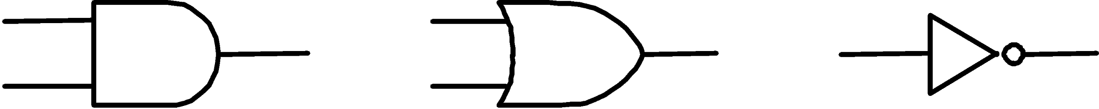
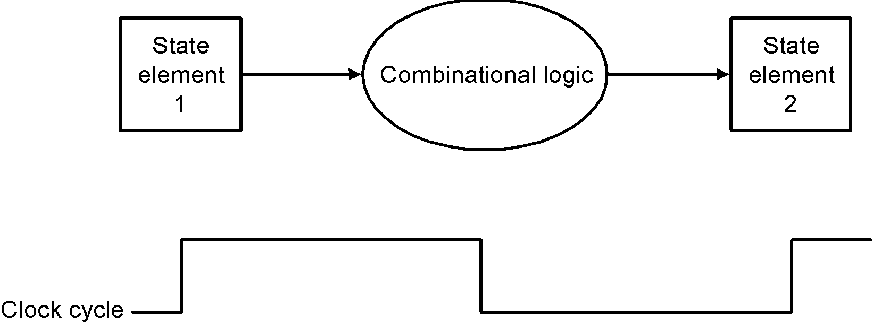
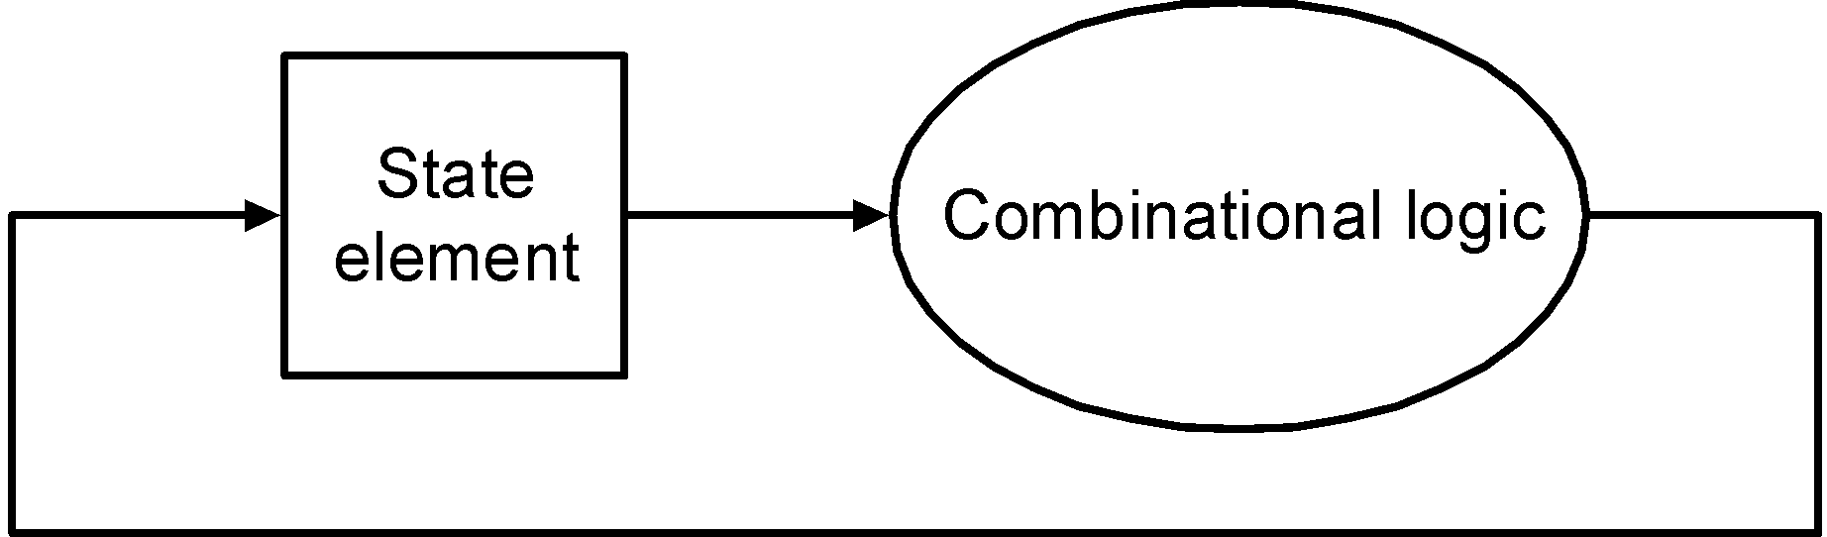
Combinational Elements
Works as an input ⇒ output function, e.g., ALU
Combinational logic reads input data from one register and writes output data to another, or same, register
read/write happens in a single cycle – combinational element cannot store data from one cycle to a future one
Combinational logic hardware units

Slide 18
State Elements
Contain data in internal storage, e.g., registers and memory
All state elements together define the state of the machine
Flipflops and latches are 1-bit state elements, equivalently, they are 1-bit memories
The output(s) of a flipflop or latch always depends on the bit value stored, i.e., its state, and can be called 1/0 or high/low or true/false
The input to a flipflop or latch can change its state depending on whether it is clocked or not…

Slide 19
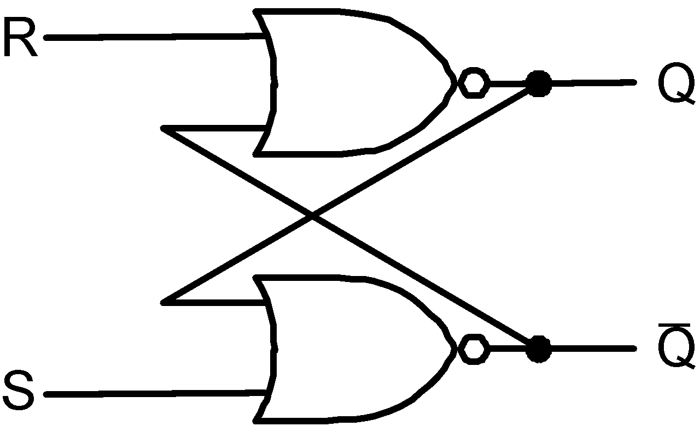
Set-Reset (SR-) latch (unclocked)
Basic memory unit
Made from two cross-coupled nand gates
When both Sbar and Rbar are 1, then either one
of the following two states is stable:
Q = 1 & Qbar = 0
Q = 0 & Qbar = 1
and the latch will continue in the current stable
state.
If Sbar changes to 0 (while Rbar remains at 1),
then the latch is forced to the exactly one
possible stable state (a). If Rbar changes to 0
(while Sbar remains at 1), the latch is forced to
the exactly one possible stable state (b).
So, the latch remembers which of Sbar or Rbar
was last 0 during the time they are both 1.
When both Sbar and Rbar are 0 the exactly one
stable state is Q = Qbar = 1. However, if after
that both Sbar and Rbar return to 1, the latch must
then jump non-deterministically to one of stable
states (a) or (b), which is undesirable behavior.
Think of Sbar as S, the inverse of set (which
sets Q to 1), and Rbar as R, the inverse of reset.
Sbar(set)
n1
Q
Rbar
(reset)
n2
Qbar
equivalently with nor gates

Slide 20
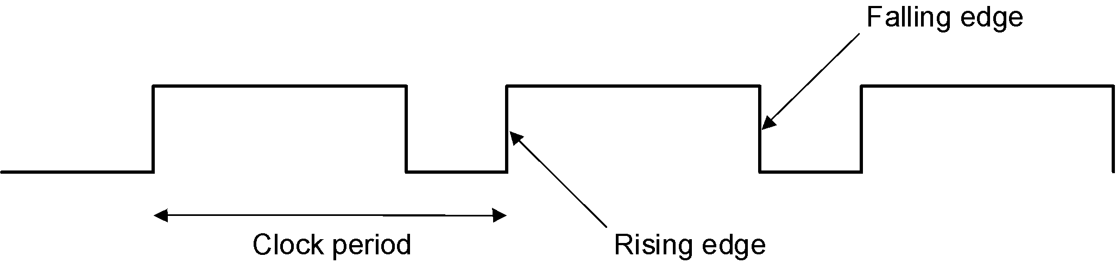
Synchronous Logic: Clocked Latches and Flipflops
Clocks are used in synchronous logic to determine when a state element is to be updated
in level-triggered clocking methodology either the state changes only when the clock is high or only when it is low (technology-dependent)
in edge-triggered clocking methodology either the rising edge or falling edge is active (depending on technology) – i.e., states change only on rising edges or only on falling edge
Latches are level-triggered
Flipflops are edge-triggered

Slide 21
Clocked SR-latch
State can change only when clock is high
Potential problem : both inputs Sbar = 0 & Rbar = 0 will cause non-deterministic behavior
Sbar
X
r1
n1
Q
clk
a
clkbar
Rbar
r2
n2
Qbar
Y

Slide 22
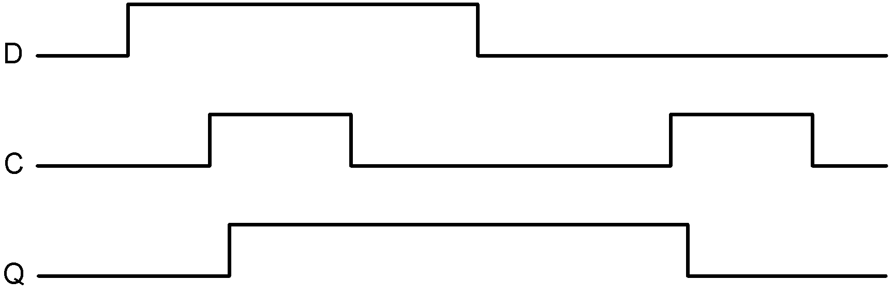
Clocked D-latch
State can change only when clock is high
Only single data input (compare SR-latch)
No problem with non-deterministic behavior
D
a2
Dbar
X
r1
n1
Q
clk
clkbar
a1
r2
n2
Qbar
Y
Timing diagram of D-latch

Slide 23
Clocked D-flipflop
Negative edge-triggered
Made from three SR-latches
sbar
clear
cbar
s
q
clkbar
clk
r
qbar
rbar
d

Slide 24
Logi Sim
All components that we have discussed – and shall discuss – can be fabricated using Logi Sim

Slide 25
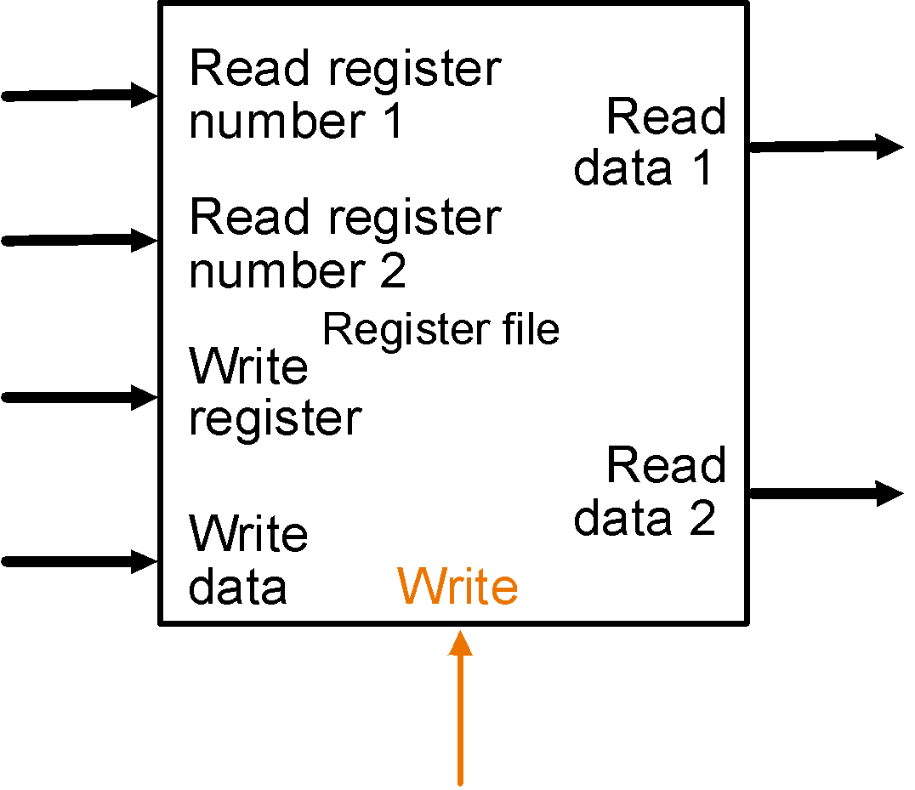
State Elements on the Datapath: Register File
Registers are implemented with arrays of D-flipflops
Clock
5 bits
32 bits
5 bits
5 bits
32 bits
32 bits
Control signal
Register file with two read ports and one write port

Slide 26
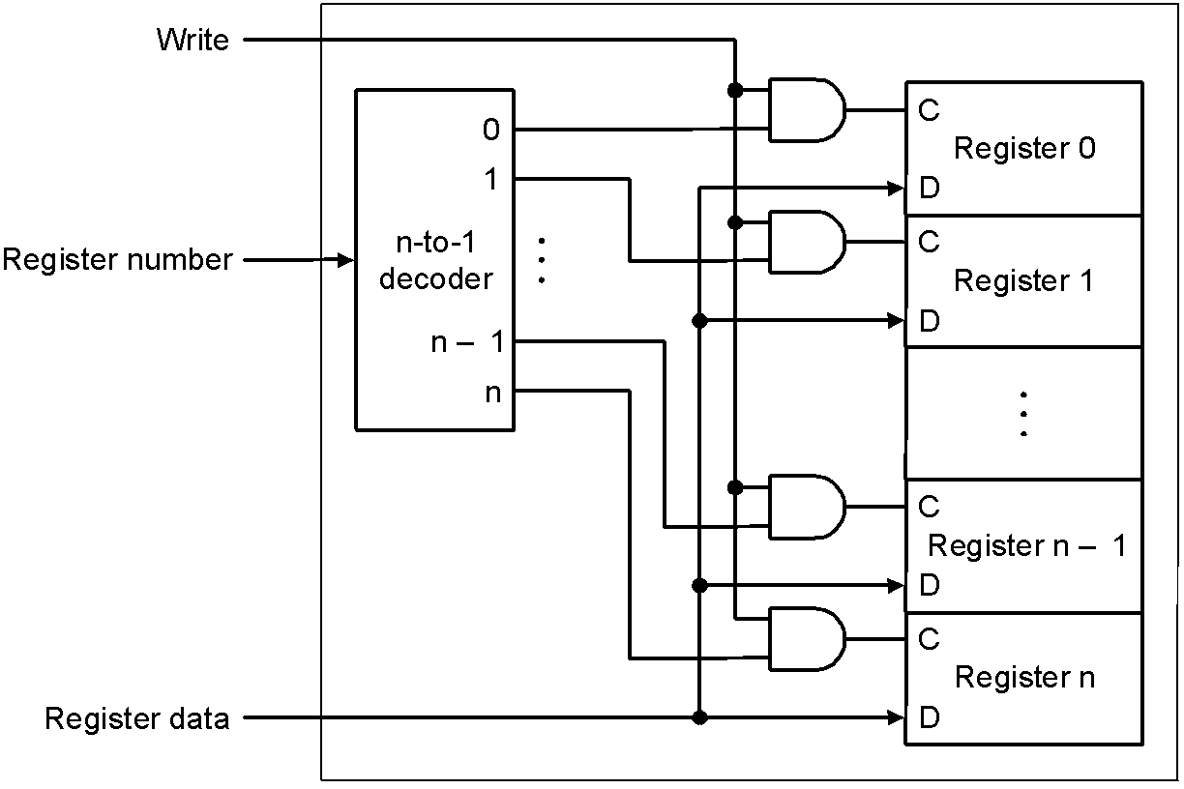
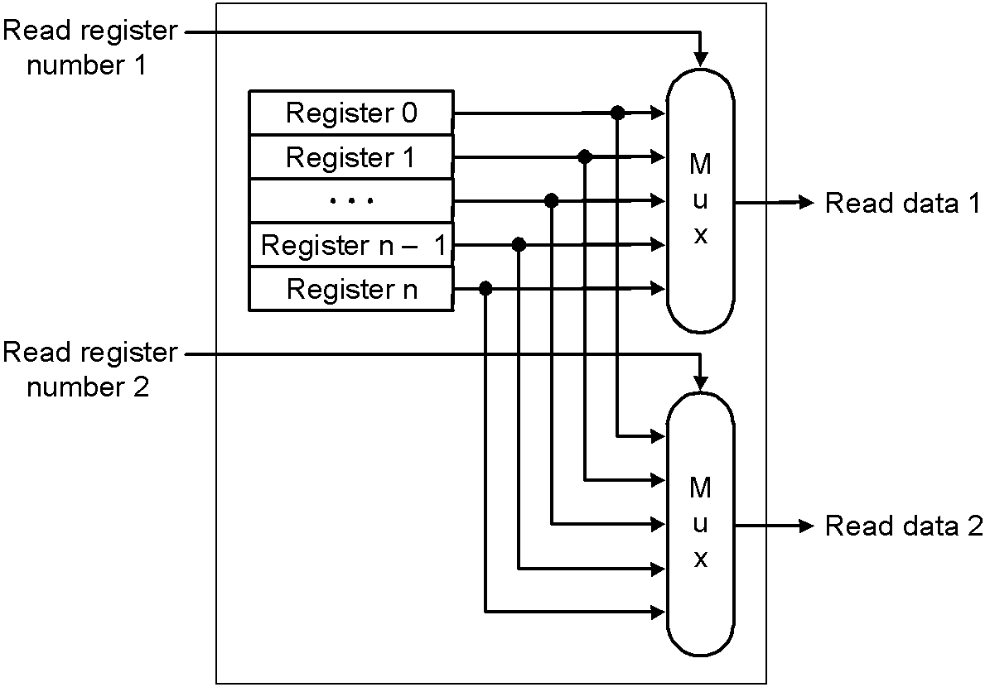
State Elements on the Datapath: Register File
Port implementation:
Clock
Clock
Read ports are implemented
with a pair of multiplexors – 5
bit multiplexors for 32 registers
Write port is implemented using
a decoder – 5-to-32 decoder for
32 registers. Clock is relevant to
write as register state may change
only at clock edge

Slide 27
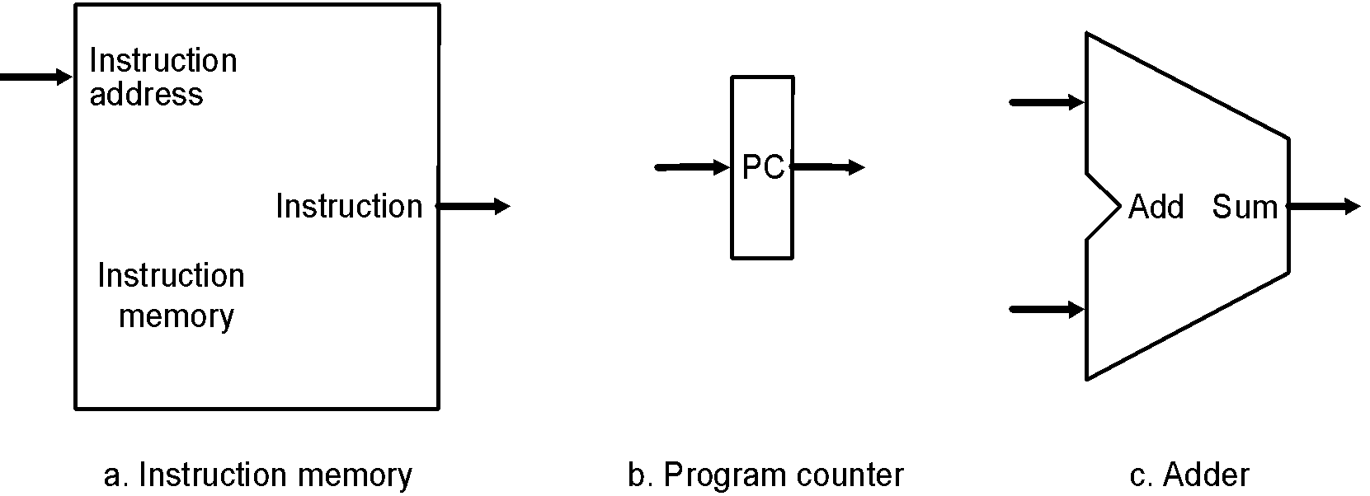
Datapath: Instruction Store/Fetch & PC Increment
Three elements used to store and fetch instructions and increment the PC

Slide 28
Datapath: Instruction Store/Fetch & PC Increment
Three elements used to store and fetch instructions and increment the PC

Slide 29
Datapath: Instruction Store/Fetch & PC Increment
Three elements used to store and fetch instructions and increment the PC

Slide 30
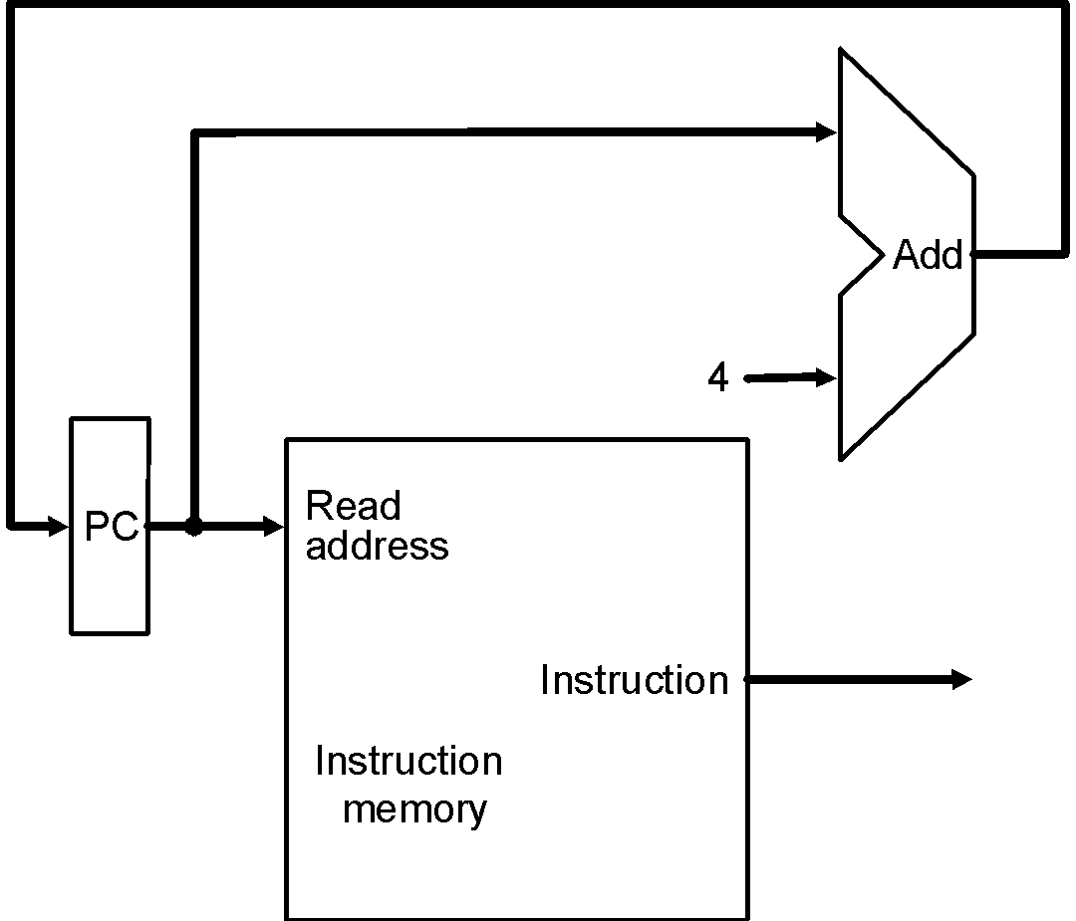
Datapath: Instruction Store/Fetch & PC Increment
Three elements used to store and fetch instructions and increment the PC
Datapath

Slide 31
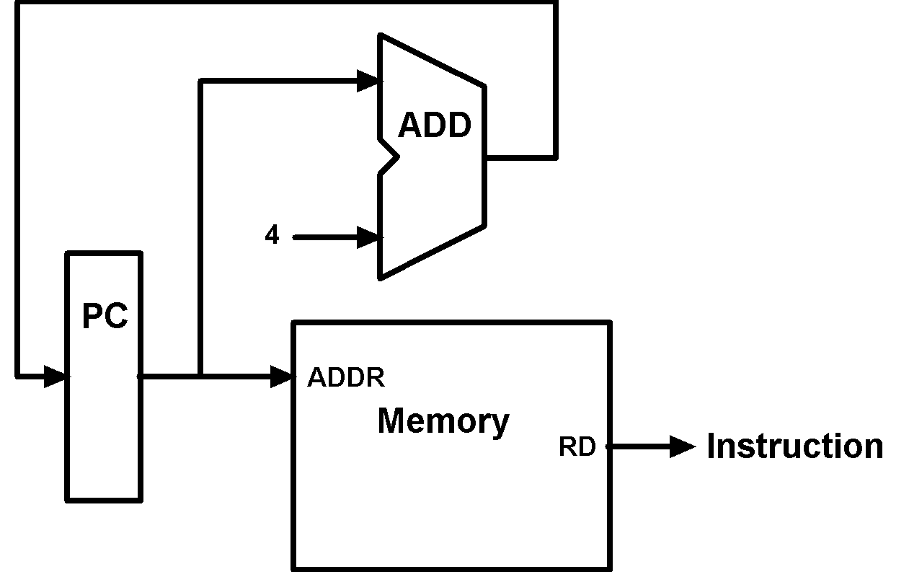
Animating the Datapath
Instruction <- MEM[PC]
PC <- PC + 4

Slide 32
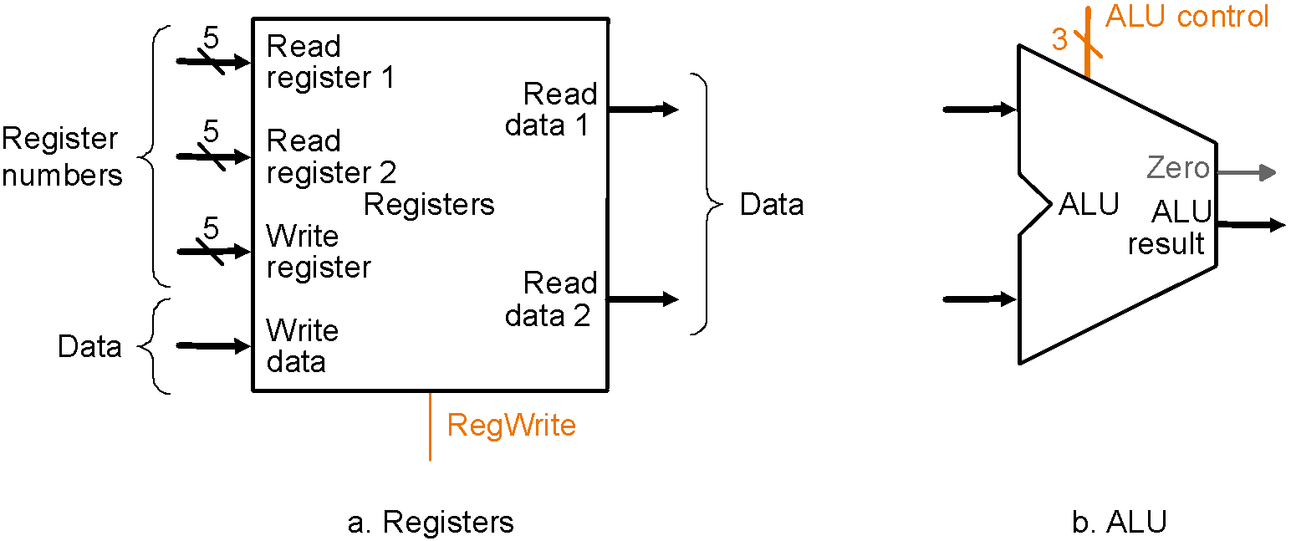
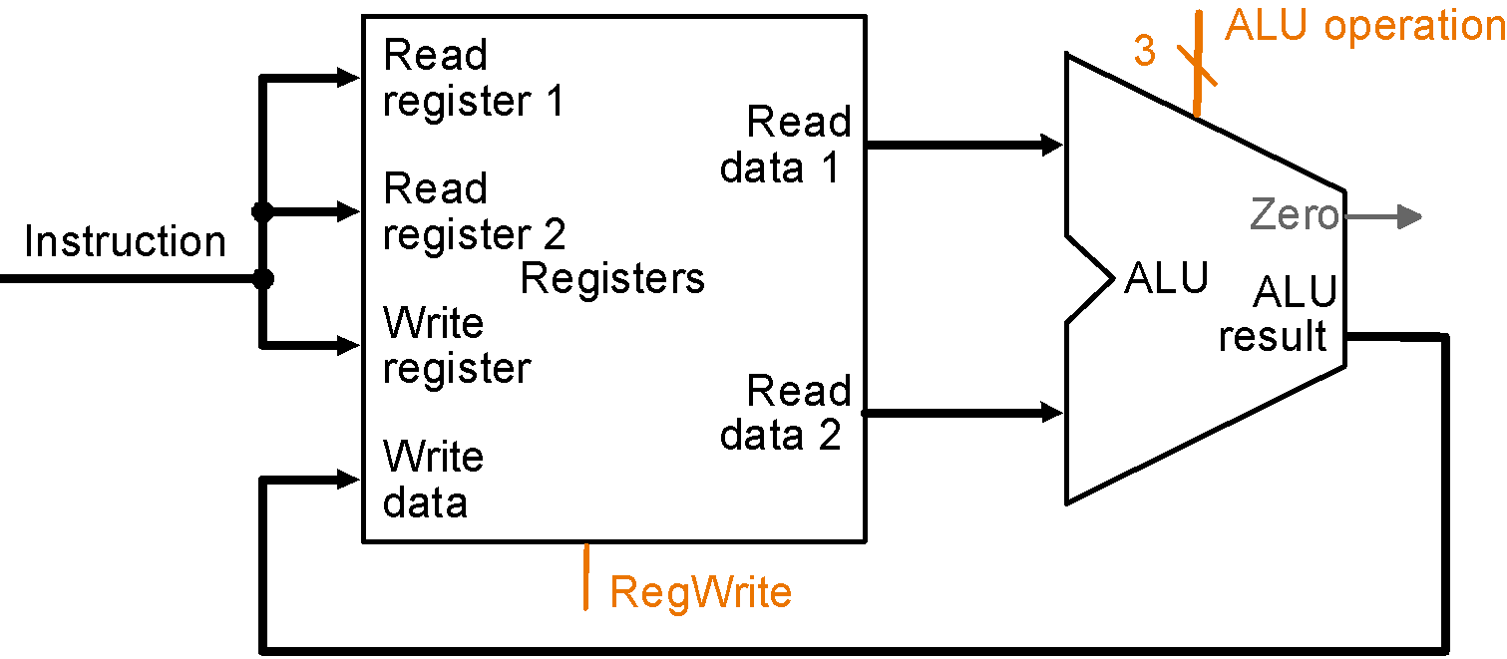
Datapath: R-Type Instruction
Two elements used to implement R-type instructions
Datapath

Slide 33
Datapath: R-Type Instruction
Two elements used to implement R-type instructions
Datapath

Slide 34
Datapath: R-Type Instruction
Two elements used to implement R-type instructions
Datapath

Slide 35
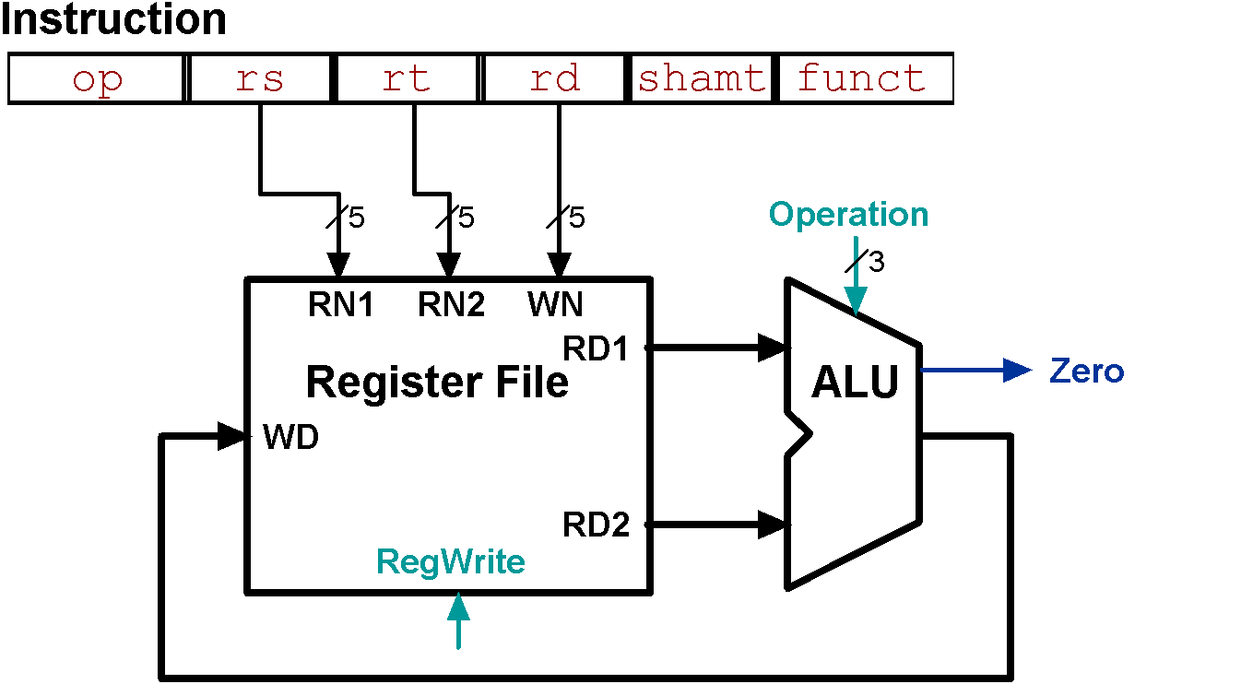
Animating the Datapath
add rd, rs, rt
R[rd] <- R[rs] + R[rt];

Slide 36
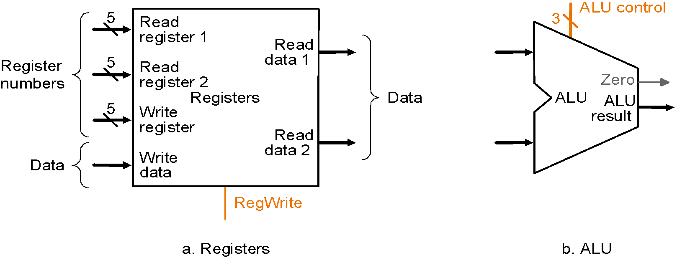
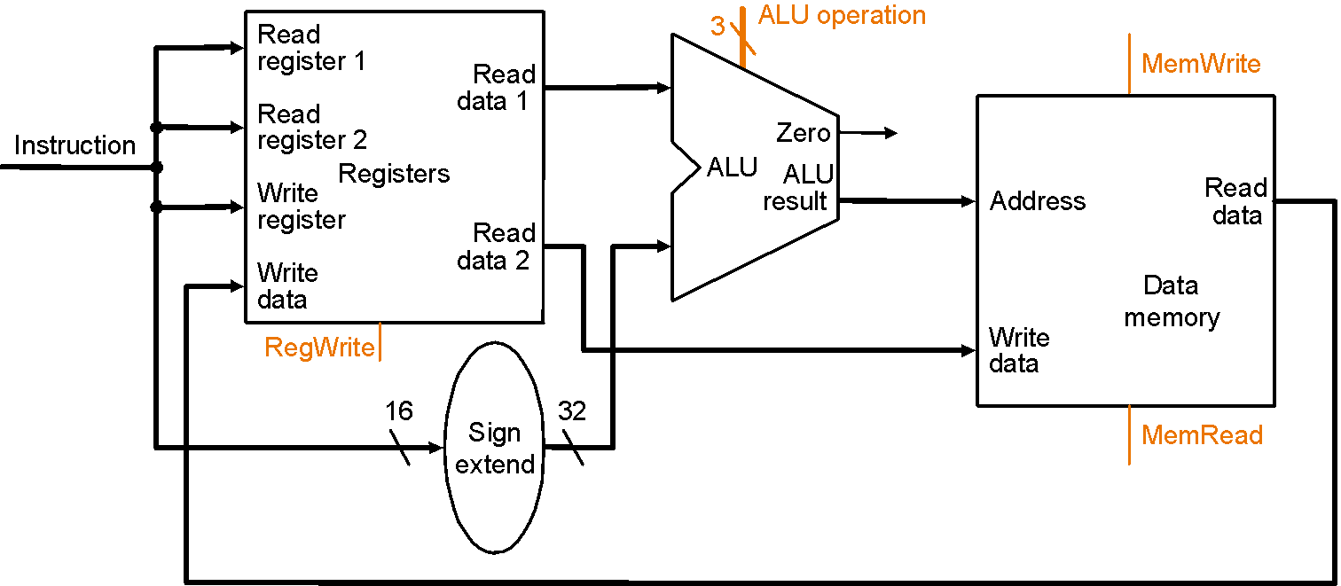
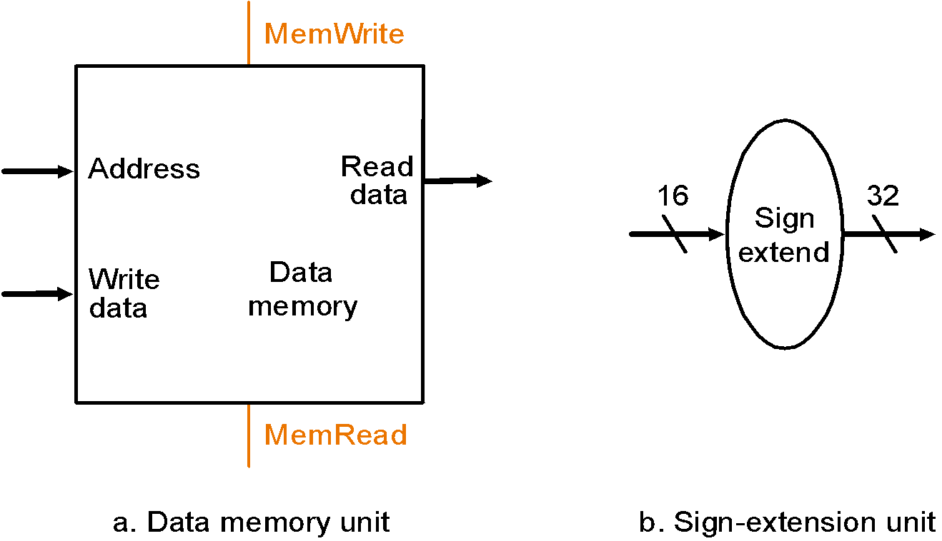
Datapath: Load/Store Instruction
Two additional elements used
To implement load/stores
Datapath

Slide 37
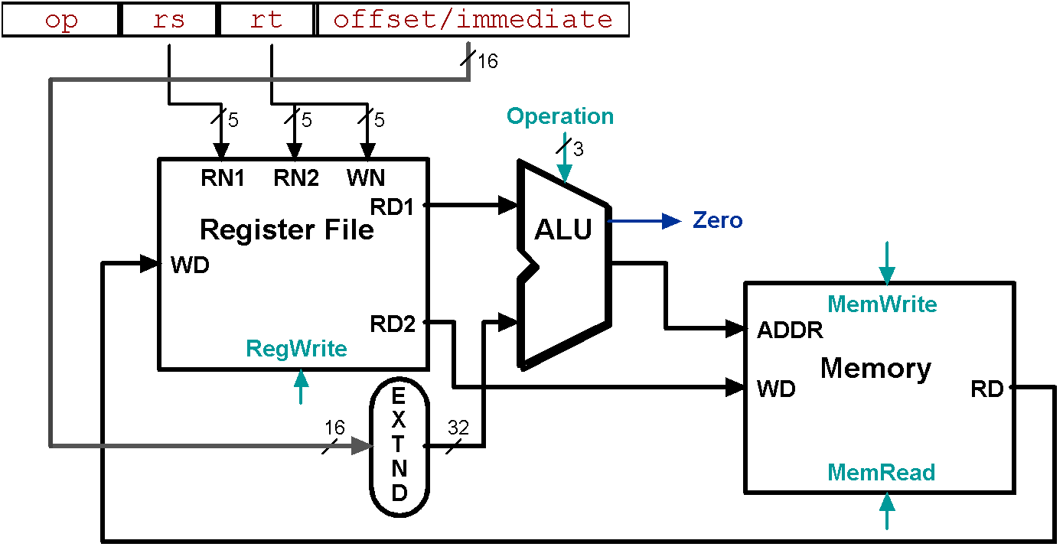
Animating the Datapath
lw rt, offset(rs)
R[rt] <- MEM[R[rs] + s_extend(offset)];

Slide 38
Animating the Datapath
sw rt, offset(rs)
MEM[R[rs] + sign_extend(offset)] <- R[rt]

Slide 39
Recall: Branch Addressing
Branch instructions:
beq rs, rt, L1
bne rs, rt, L1
Specify:
Opcode, two registers, target address
Format:
16 bit Address ?
op rs rt constant or address
6 bits 5 bits 5 bits 16 bits

Slide 40
Recall: Branch Addressing
16 bits is too small a reach in a 2³² address space
Solution:
Principle of locality
Most branch targets are near branch
Forward or backward Direction
Use PC (= program counter), called PC-relative addressing based on Principle of Locality
PC-relative addressing
Target address = PC + offset × 4
PC already incremented by 4 by this time

Slide 41
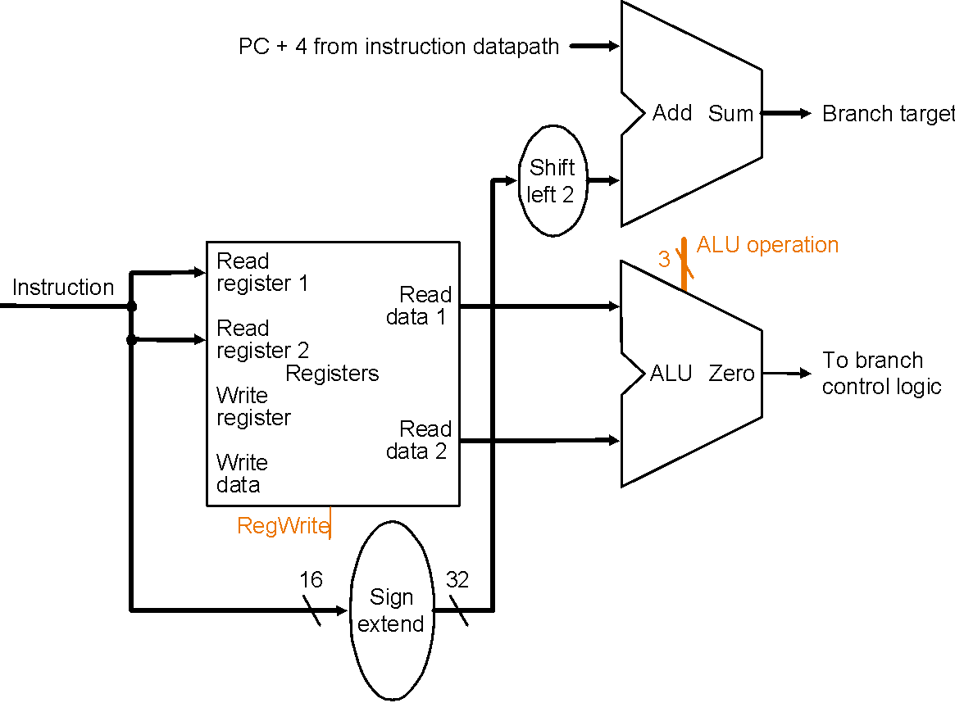
Datapath: Branch Instruction
How to?
No shift hardware required:
simply connect wires from
input to output, each shifted
left 2 bits
Datapath

Slide 42
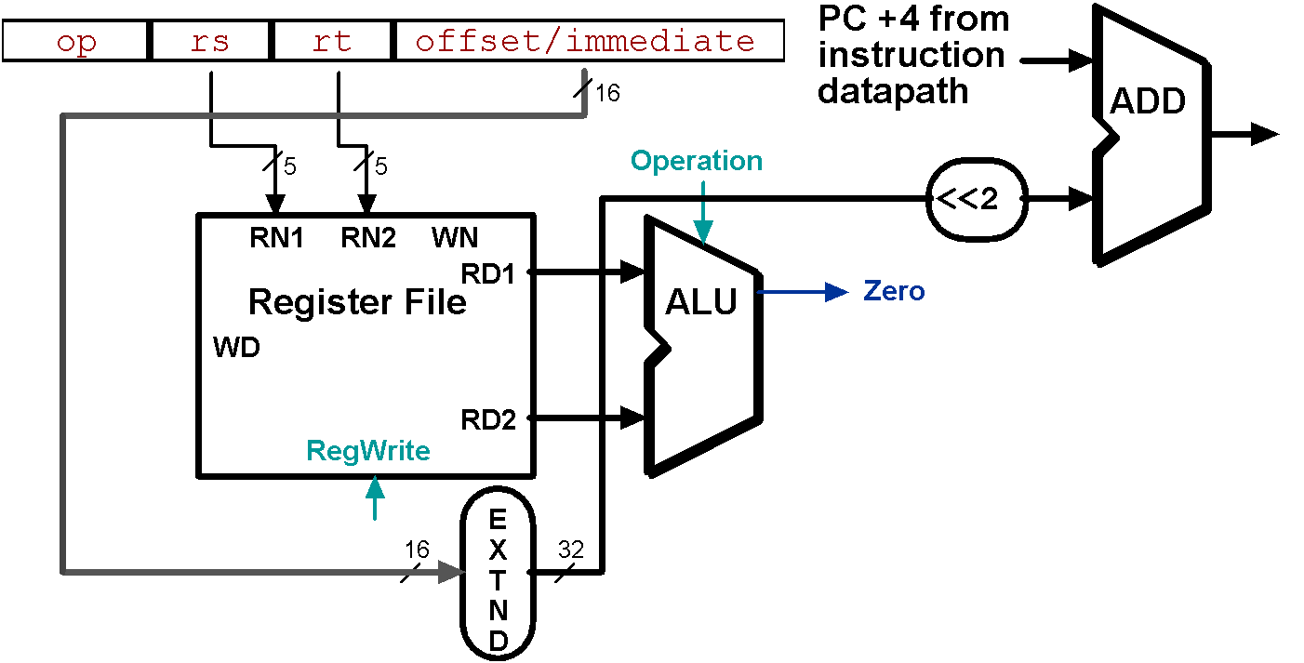
Animating the Datapath
beq rs, rt, offset
if (R[rs] == R[rt]) then PC 🡨 PC+4 + s_extend(offset<<2)

Slide 43
Composing of the Elements
Each datapath element can only do one function at a time
Check possibility
Need separate instruction and data memories
Use multiplexers where alternate data sources are used for different instructions

Slide 44
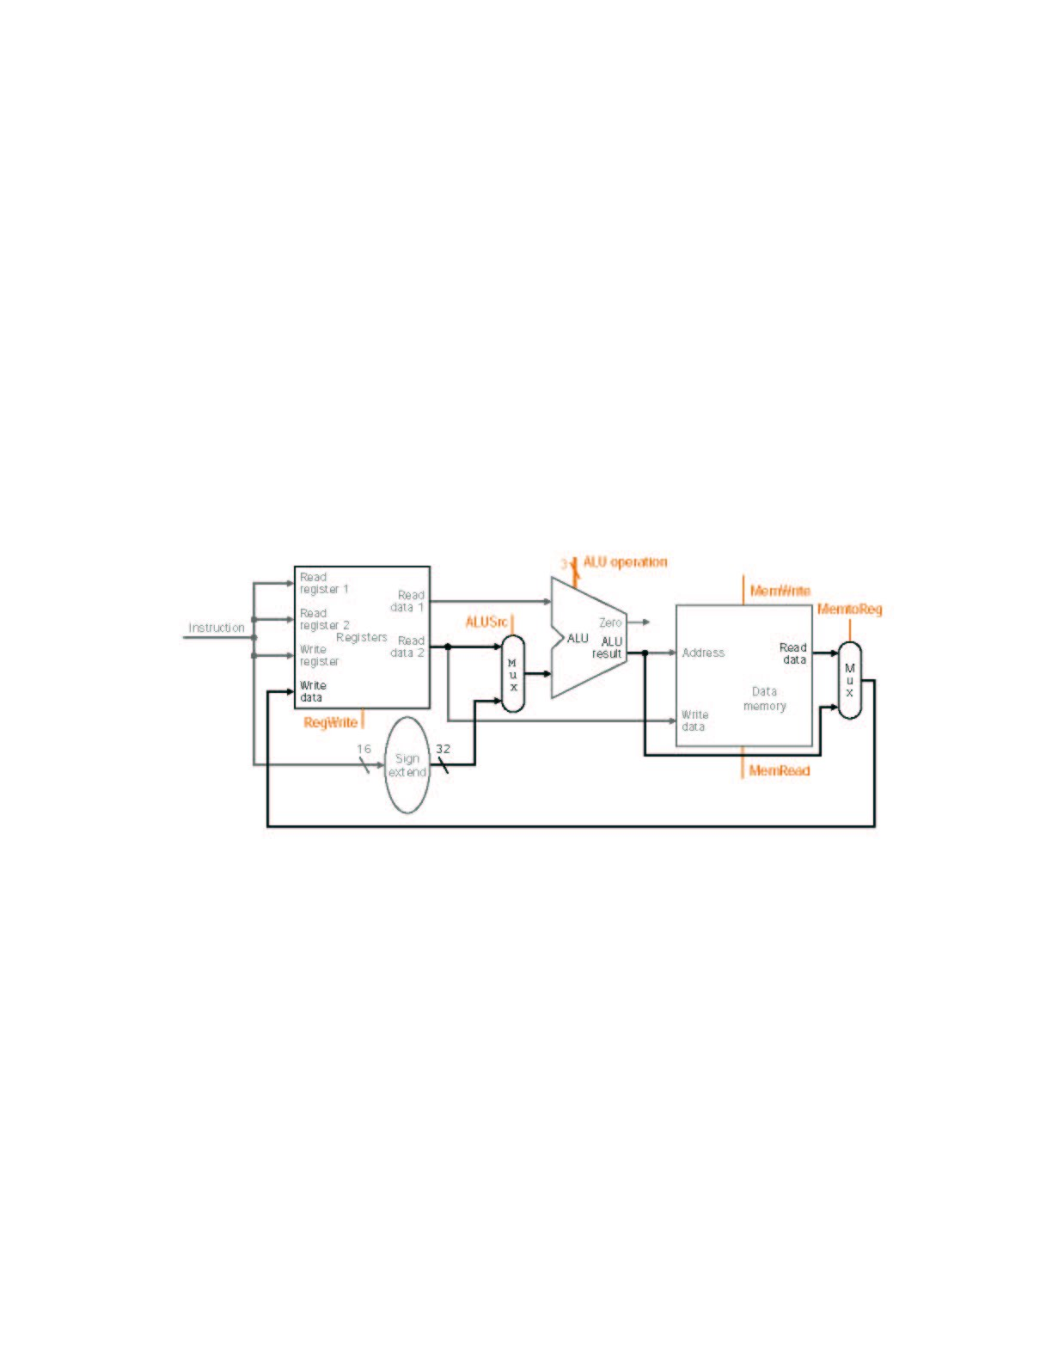
MIPS Datapath I: Single-Cycle
Input is either register (R-type) or sign-extended
lower half of instruction (load/store)
Data is either
from ALU (R-type)
or memory (load)
Combining the datapaths for R-type instructions
and load/stores using two multiplexors

Slide 45
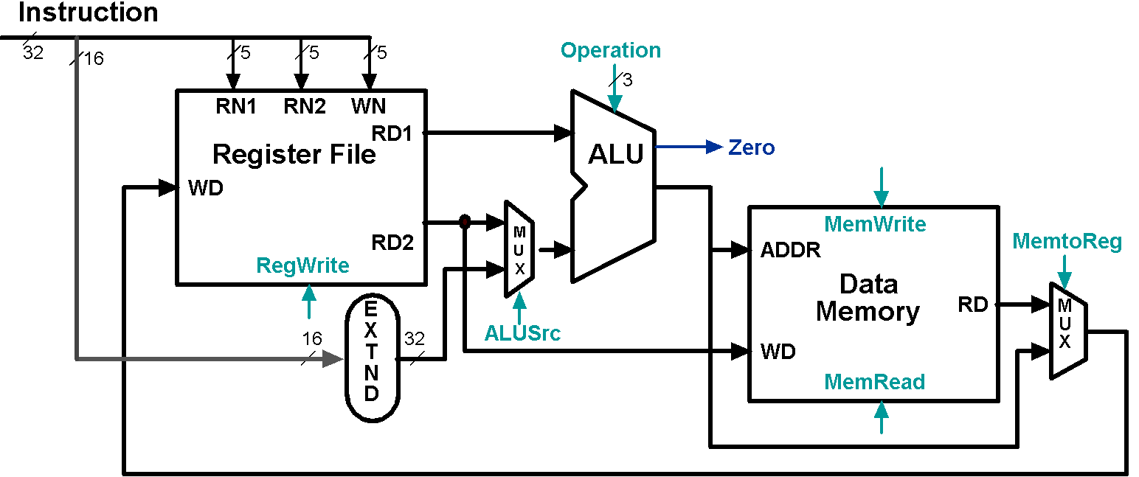
Animating the Datapath: R-type Instruction
add rd,rs,rt

Slide 46
Animating the Datapath: Load Instruction
lw rt,offset(rs)

Slide 47
Animating the Datapath: Store Instruction
sw rt,offset(rs)

Slide 48
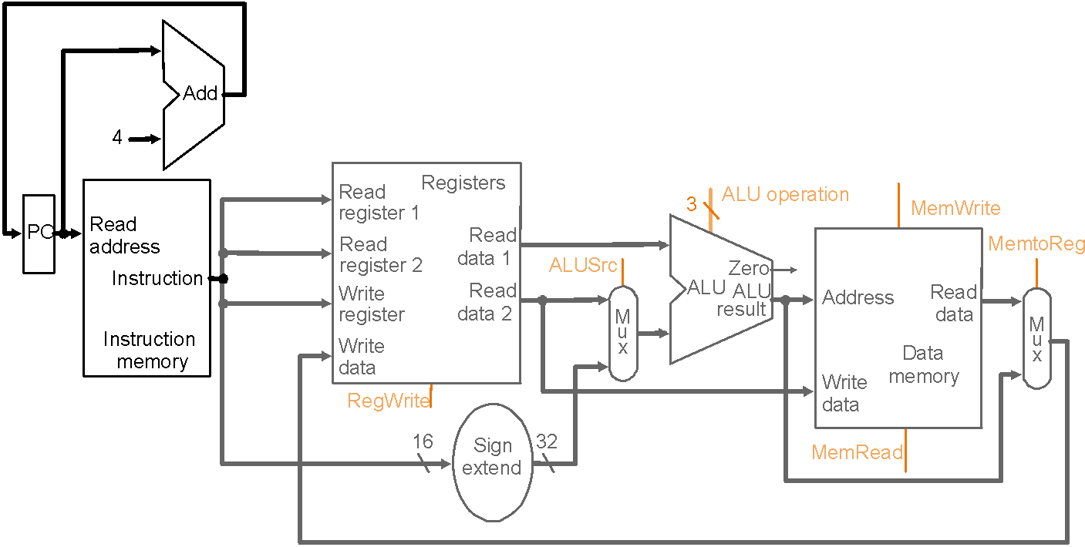
MIPS Datapath II: Single-Cycle
Separate adder as ALU operations and PC
increment occur in the same clock cycle
Separate instruction memory
as instruction and data read
occur in the same clock cycle
Adding instruction fetch

Slide 49
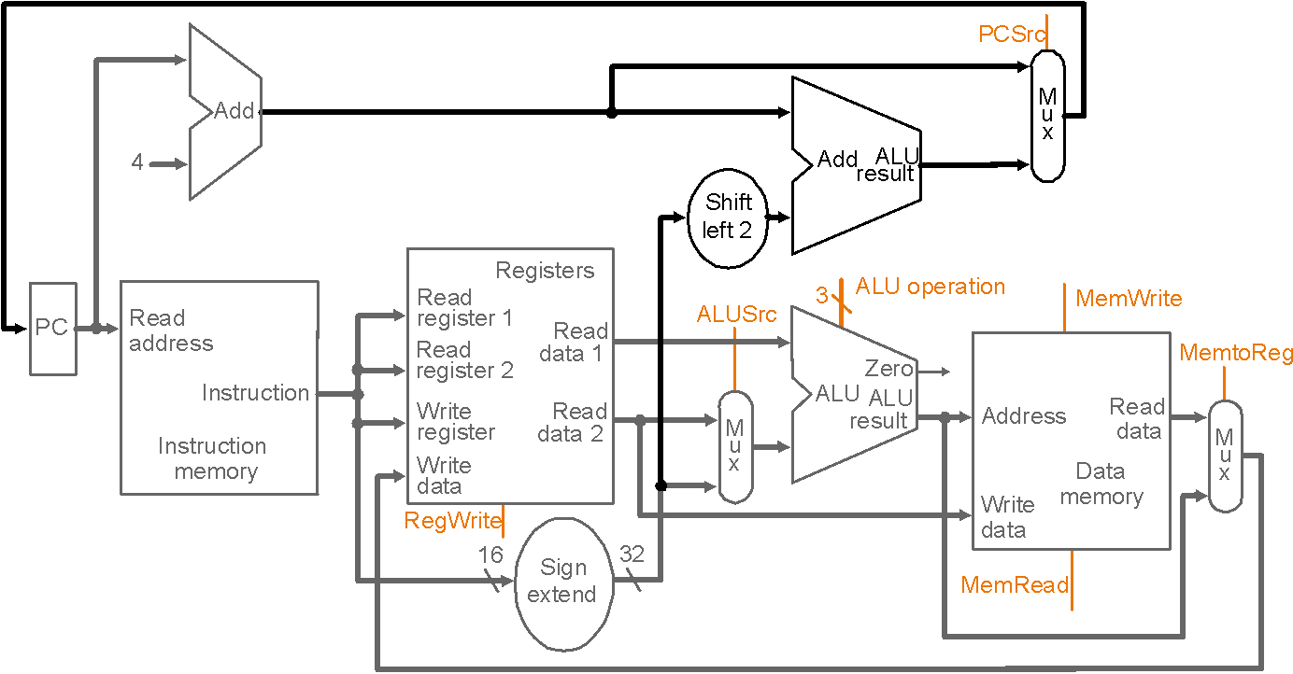
MIPS Datapath III: Single-Cycle
New multiplexor
Extra adder needed as both
adders operate in each cycle
Instruction address is either
PC+4 or branch target address
Adding branch capability and another multiplexor
Important note: in a single-cycle implementation data cannot be stored
during an instruction – it only moves through combinational logic

Slide 50
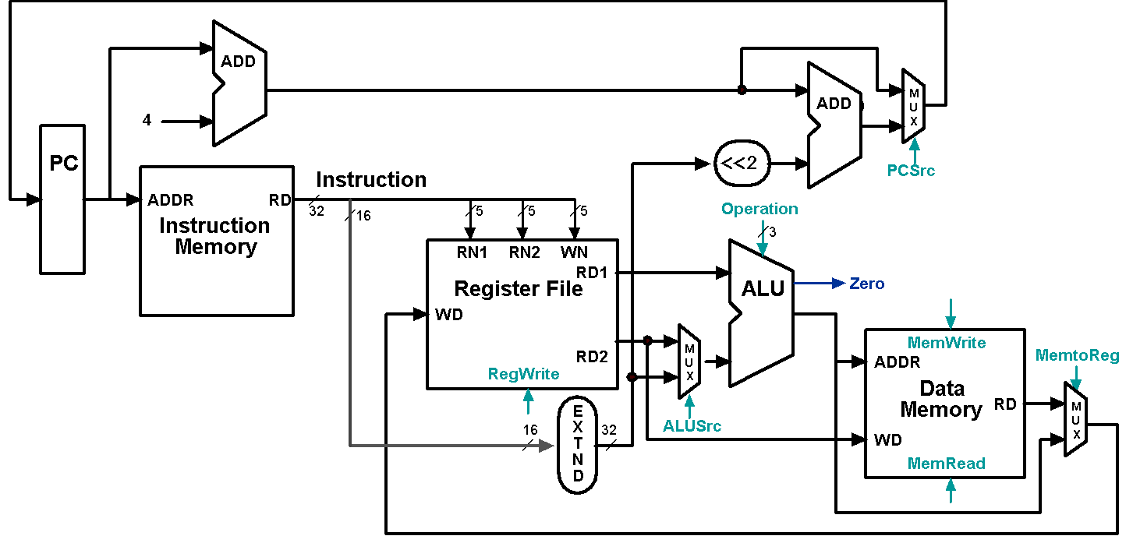
Datapath Executing add
add rd, rs, rt

Slide 51
Datapath Executing lw
lw rt,offset(rs)

Slide 52
Datapath Executing sw
sw rt,offset(rs)

Slide 53
Datapath Executing beq
beq r1,r2,offset

Slide 54
Control
Control unit takes input from
The instruction opcode bits
Control unit generates
Write enable (possibly, read enable also) signals for each storage element
Selector controls for each multiplexor
ALU control input

Slide 55
Designing the Main Control
R-type
opcode
rs
rt
rd
shamt
funct
31-26
25-21
20-16
15-11
10-6
5-0
Load/store
or branch
opcode
rs
rt
address
31-26
25-21
20-16
15-0
Observations about MIPS instruction format
opcode is always in bits 31-26
two registers to be read are always rs (bits 25-21) and rt (bits 20-16)
base register for load/stores is always rs (bits 25-21)
16-bit offset for branch equal and load/store is always bits 15-0
destination register for loads is in bits 20-16 (rt) while for R-type instructions it is in bits 15-11 (rd) (will require multiplexor to select)

Slide 56
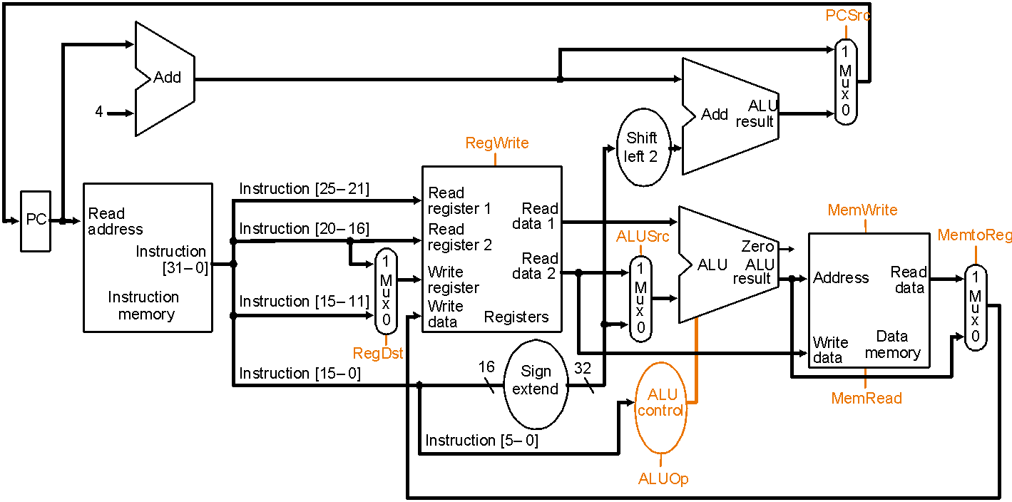
Datapath with Control I
New multiplexor
Adding control to the MIPS Datapath III (and a new multiplexor to select field to
specify destination register)

Slide 57
Control Signals
Signal Name Effect when deasserted Effect when asserted
RegDst The register destination number for the The register destination number for the
Write register comes from the rt field (bits 20-16) Write register comes from the rd field (bits 15-11)
RegWrite None The register on the Write register input is written
with the value on the Write data input
AlLUSrc The second ALU operand comes from the The second ALU operand is the sign-extended,
second register file output (Read data 2) lower 16 bits of the instruction
PCSrc The PC is replaced by the output of the adder The PC is replaced by the output of the adder
that computes the value of PC + 4 that computes the branch target
MemRead None Data memory contents designated by the address
input are put on the first Read data output
MemWrite None Data memory contents designated by the address
input are replaced by the value of the Write data input
MemtoReg The value fed to the register Write data input The value fed to the register Write data input
comes from the ALU comes from the data memory
Effects of the seven control signals

Slide 58
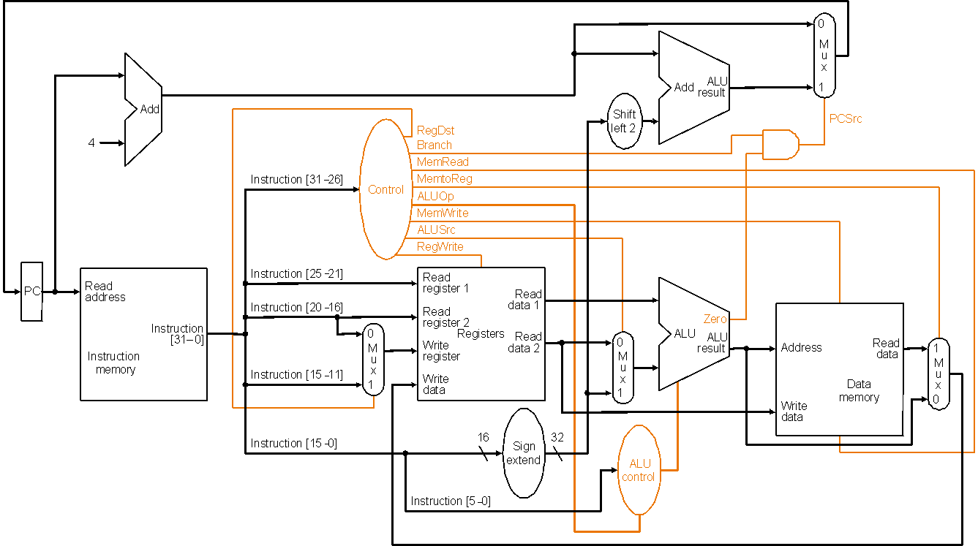
Datapath with Control II
MIPS datapath with the control unit: input to control is the 6-bit instruction
opcode field, output is seven 1-bit signals and the 2-bit ALUOp signal

Slide 59
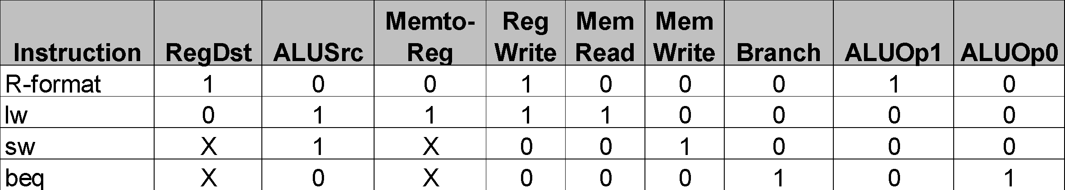
Datapath with Control II (cont.)
PCSrc cannot be
set directly from the
opcode: zero test
outcome is required
Determining control signals for the MIPS datapath based on instruction opcode

Slide 60
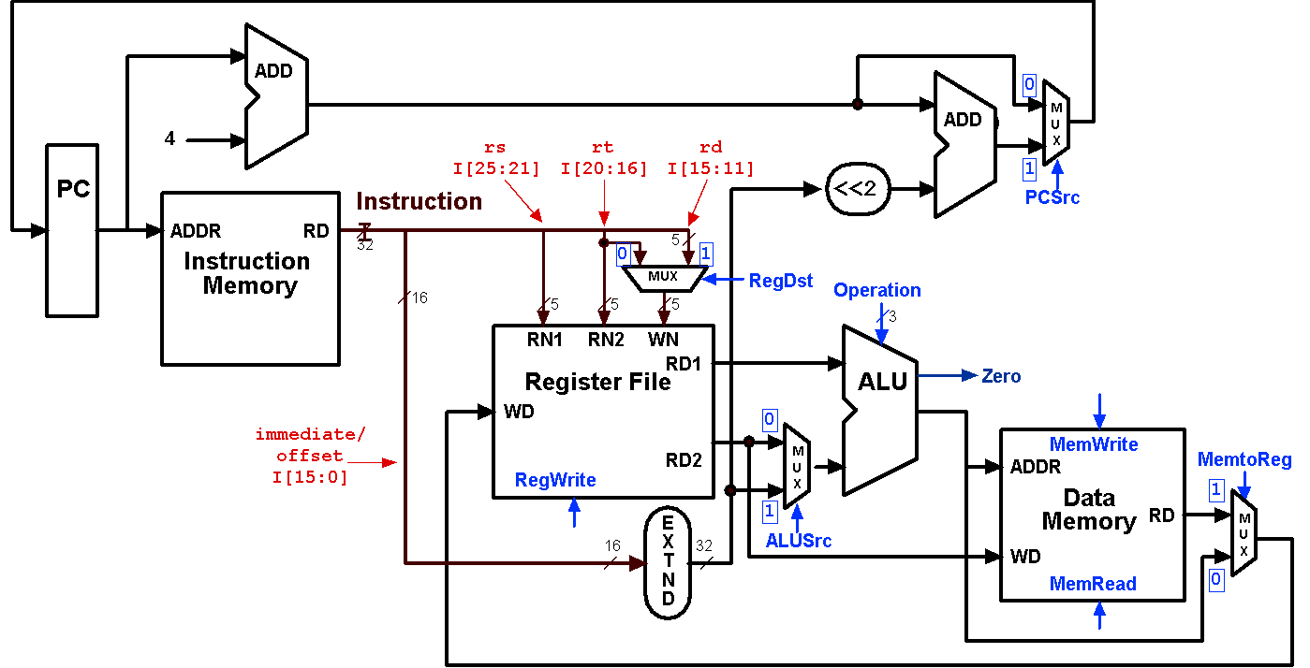
Control Signals: R-Type Instruction
0
???
Value depends on funct
1
0
0
1
Control signals
shown in blue
0
0

Slide 61
Control Signals: lw Instruction
0
010
0
0
1
1
Control signals
shown in blue
1
1

Slide 62
Control Signals: sw Instruction
0
010
X
1
X
0
Control signals
shown in blue
1
0

Slide 63
Control Signals: beq Instruction
1 if Zero=1
110
X
0
X
0
Control signals
shown in blue
0
0

Slide 64
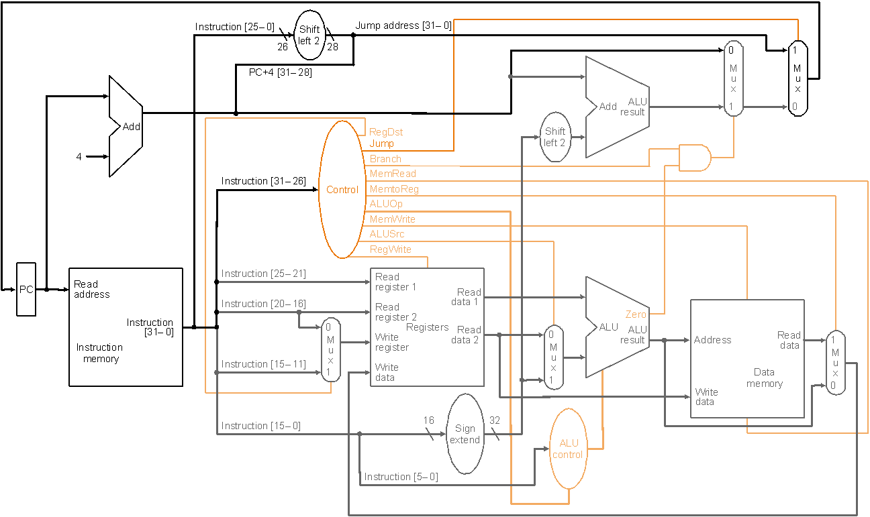
Datapath with Control III
Jump
opcode
address
31-26
Composing jump
target address
25-0
New multiplexor with additional
control bit Jump
MIPS datapath extended to jumps: control unit generates new Jump control bit

Slide 65
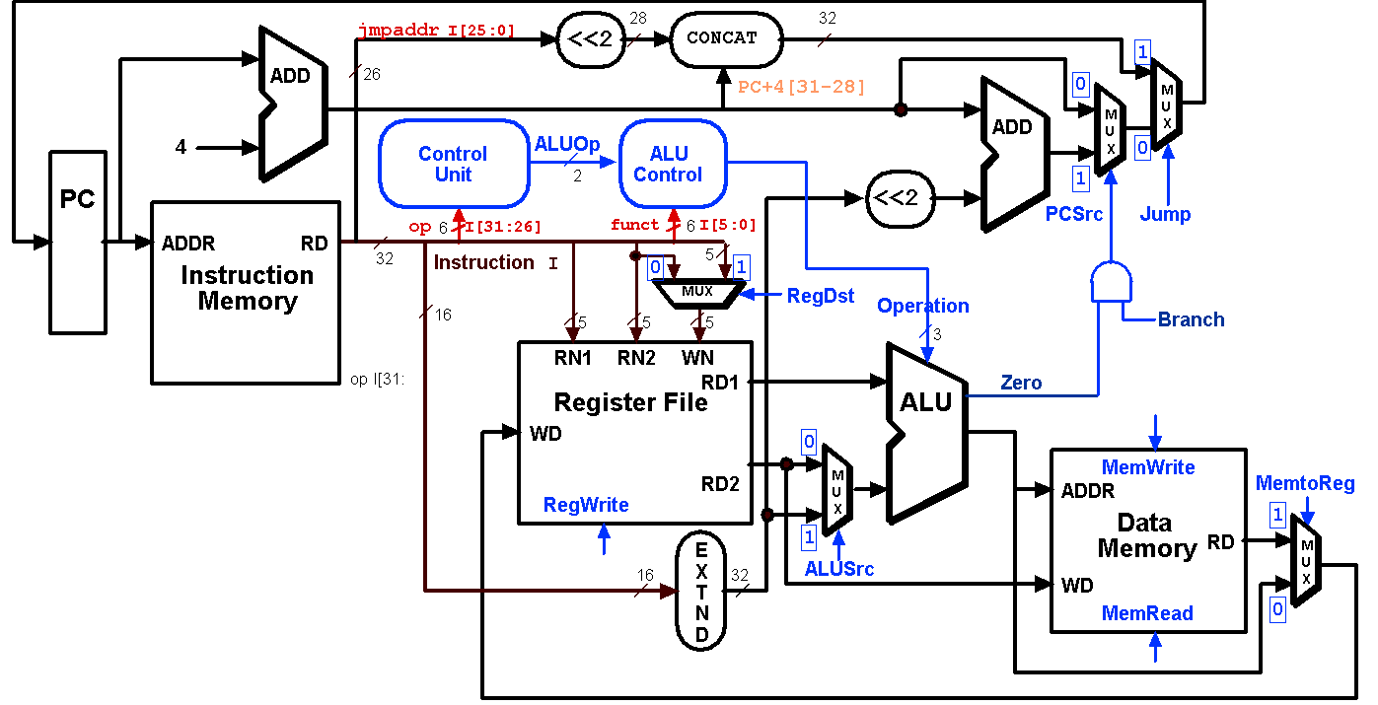
Datapath Executing j

Slide 66
R-Type Instruction Steps add $t1, $t2, $t3
Fetch instruction and increment PC
Read two source registers from the register file
ALU operates on the two register operands
Write result to register

Slide 67
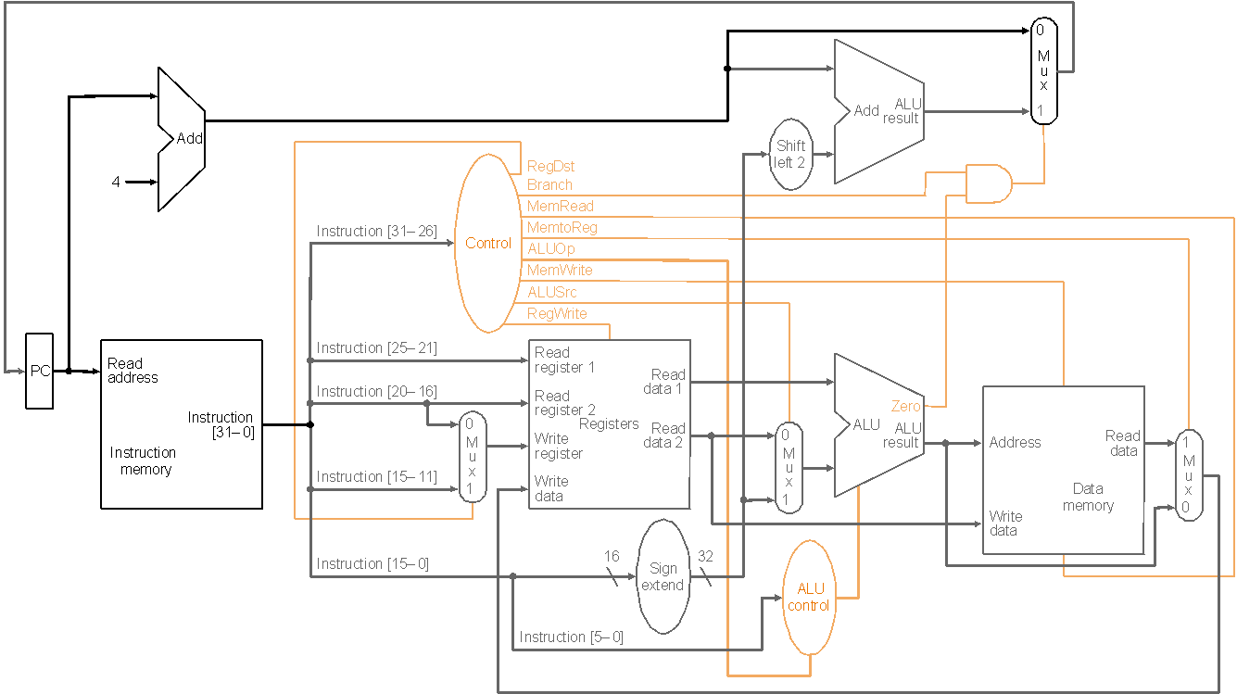
R-type Instruction: Step 1 add $t1, $t2, $t3 (active = bold)
Fetch instruction and increment PC count

Slide 68
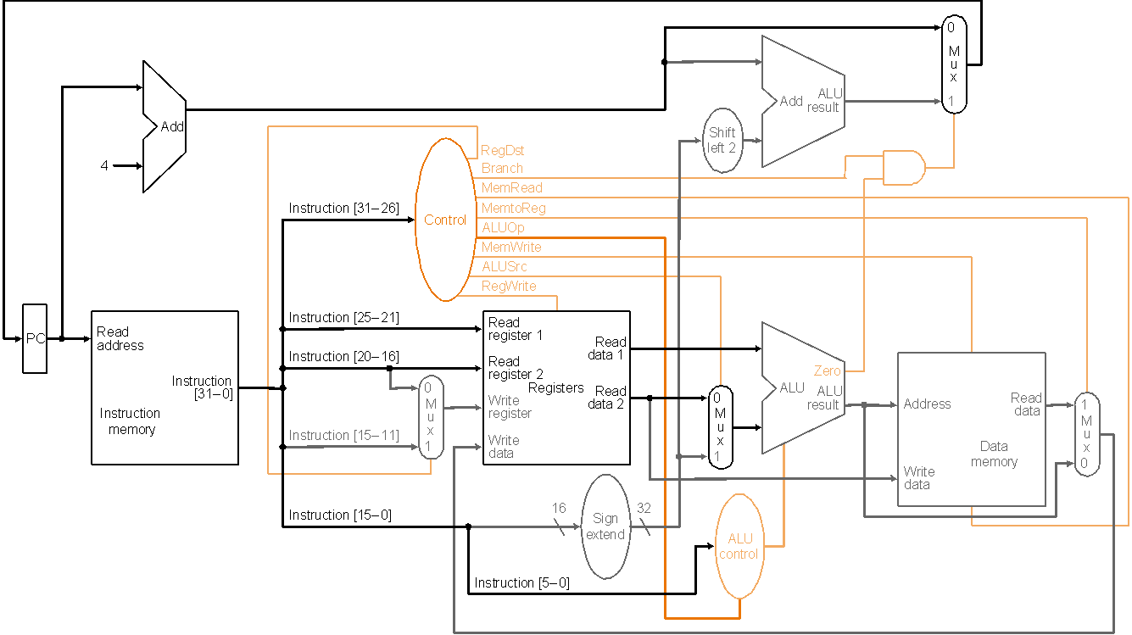
R-type Instruction: Step 2 add $t1, $t2, $t3 (active = bold)
Read two source registers from the register file

Slide 69
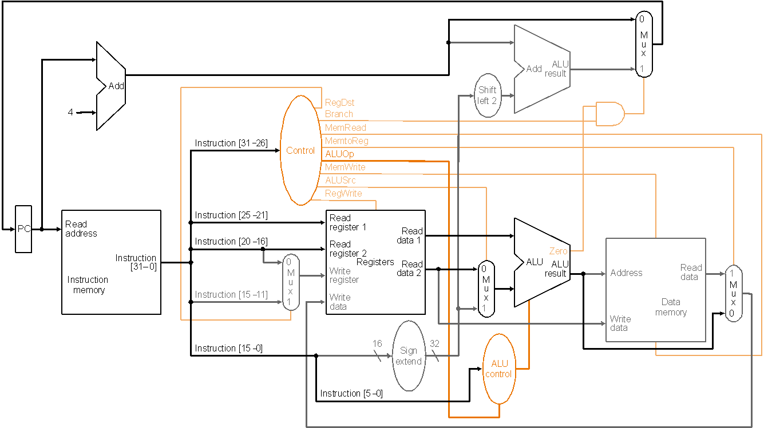
R-type Instruction: Step 3 add $t1, $t2, $t3 (active = bold)
ALU operates on the two register operands

Slide 70
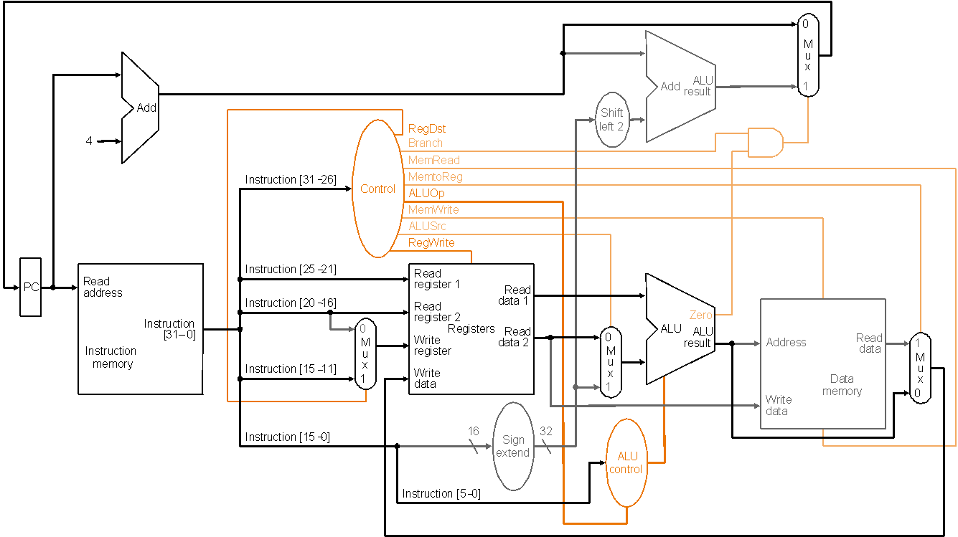
R-type Instruction: Step 4 add $t1, $t2, $t3 (active = bold)
Write result to register

Slide 71
Load Instruction Steps lw $t1, offset($t2)
Fetch instruction and increment PC
Read base register from the register file: the base register ($t2) is given by bits 25-21 of the instruction
ALU computes sum of value read from the register file and the sign-extended lower 16 bits (offset) of the instruction
The sum from the ALU is used as the address for the data memory
The data from the memory unit is written into the register file: the destination register ($t1) is given by bits 20-16 of the instruction

Slide 72

Load Instruction lw $t1, offset($t2)

Slide 73
Branch Instruction Steps beq $t1, $t2, offset
Fetch instruction and increment PC
Read two register ($t1 and $t2) from the register file
ALU performs a subtract on the data values from the register file; the value of PC+4 is added to the sign-extended lower 16 bits (offset) of the instruction shifted left by two to give the branch target address
The Zero result from the ALU is used to decide which adder result (from step 1 or 3) to store in the PC

Slide 74

Branch Instruction beq $t1, $t2, offset

